Slide 1
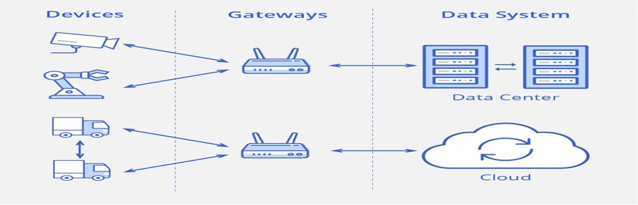
Types of IoT Connections
.
The data moves between these levels via four types of transmission channels.

Slide 2
Device to device (D2D) — direct contact between two smart objects when they share information instantaneously without intermediaries. For example, industrial robots and sensors are connected to one another directly to coordinate their actions.
This type of connection is not very common yet, because most devices are not able to handle such processes.

Slide 3
Device to gateway — telecommunications between sensors and gateway nodes. Gateways are more powerful computing devices than sensors.
They have two main functions:
To consolidate data from sensors and route it to the relevant data system;
To analyze data and, if some problems are found, return it back to the device.

Slide 4
Gateway to data systems — data transmission from a gateway to the appropriate data system.
To determine what protocol to use, you should analyze data traffic (frequency of burstiness and congestion, security requirements and how many parallel connections are needed).

Slide 5
Between data systems — information transfer within data centers or clouds. Protocols for this type of connection should be easy to deploy and integrate with existing apps, have high availability, capacity and reliable disaster recovery.

Slide 6
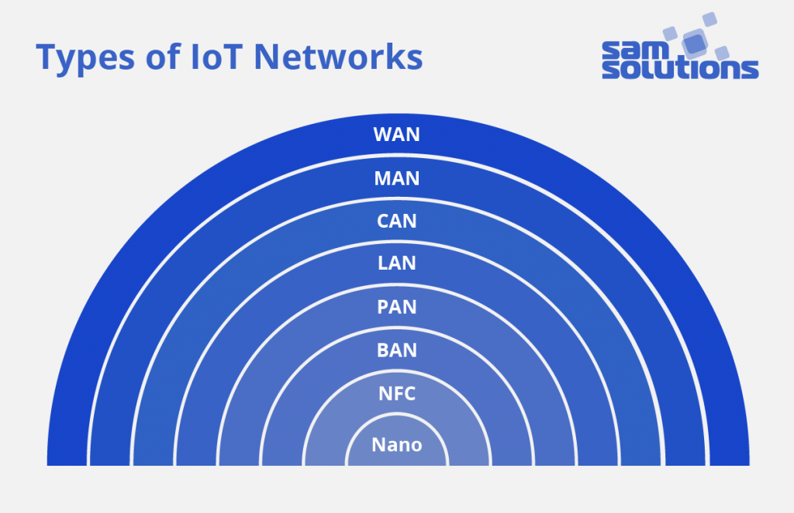
Types of IoT Networks
Networks are divided into categories based on the distance range they provide.

Slide 7
A nanonetwork — a set of small devices (sized a few micrometers at most) that perform very simple tasks such as sensing, computing, storing, and actuation. Such systems are applied in the biometrical, military.

Slide 8
NFC (Near-Field Communication) — a low-speed network to connect electronic devices at a distance within 4 cm from each other. Possible applications are contactless payment systems.
BAN (Body Area Network) — a network to connect wearable computing devices that can be worn either fixed on the body, or near the body in different positions, or embedded inside the body (implants).

Slide 9
PAN (Personal Area Network) — a net to link up devices within a radius of roughly one or a couple of rooms.
LAN (Local Area Network) — a network covering the area of one building.
CAN (Campus/Corporate Area Network) — a network that unites smaller local area networks within a limited geographical area (enterprise, university)

Slide 10
MAN (Metropolitan Area Network) — a big network for a certain metropolitan area powered by the microwave transmission technology.
WAN (Wide Area Network) — a network that exists over a large-scale geographical area and unites different smaller networks, including LANs and MANs.

Slide 11
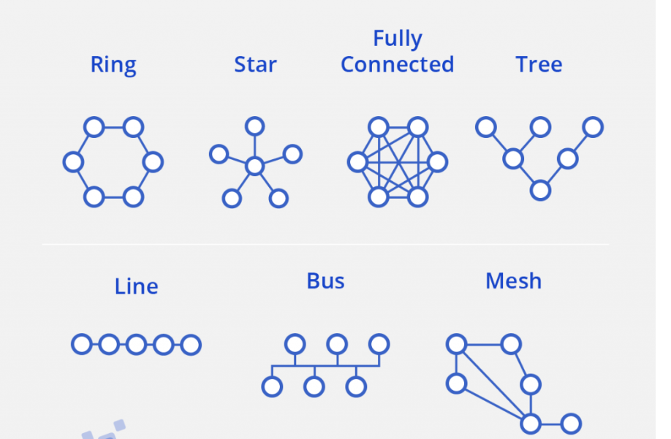
Wireless nets can also be categorized according to their topology, i.e. a connectivity configuration. There may be various combinations of connections between nodes: line, ring, star, mesh, fully connected, tree, bus.

Slide 12
Requirements for IoT Networks
The capacity to connect a large number of heterogeneous elements
High reliability
Real-time data transmission with minimum delays
The ability to protect all data flows
The ability to configure applications
Monitoring and traffic management at the device level
Cost-effectiveness for a large number of connected objects

Slide 13
Near-field communication (NFC) is a set of communication protocols that enable electronic devices, one of which is usually a portable device such as a smartphone, to establish communication by bringing them within 4 cm (1​¹⁄₂ in) of each other.
Near Field Communication (NFC) is a contact-less communication technology based on a radio frequency (RF)
NFC devices are used in contactless payment systems, similar to those used in credit cards and electronic ticket smart cards

Slide 14
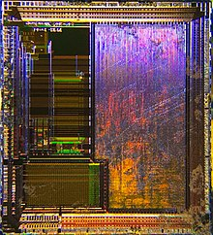
The Secure Element chip. This is an NFC chip that contains data such as the SEID (Secure Element Identifier) for secure transactions. This chip is commonly found in NFC enabled devices

Slide 15
Each full NFC device can work in three modes:
NFC card emulation Enables NFC-enabled devices such as smartphones to act like smart cards, allowing users to perform transactions such as payment or ticketing.
NFC reader/writer Enables NFC-enabled devices to read information stored on inexpensive NFC tags embedded in labels or smart posters.
NFC peer-to-peer Enables two NFC-enabled devices to communicate with each other to exchange information in an ad hoc fashion.
It operates within the globally available and unlicensed radio frequency ISM band of 13.56 MHz

Slide 16
The two modes are:
Passive The initiator device provides a carrier field and the target device answers by modulating the existing field. In this mode, the target device may draw its operating power from the initiator.
Active Both initiator and target device communicate by alternately generating their own fields.
A device deactivates its RF field while it is waiting for data.
In this mode, both devices typically have power supplies.

Slide 17
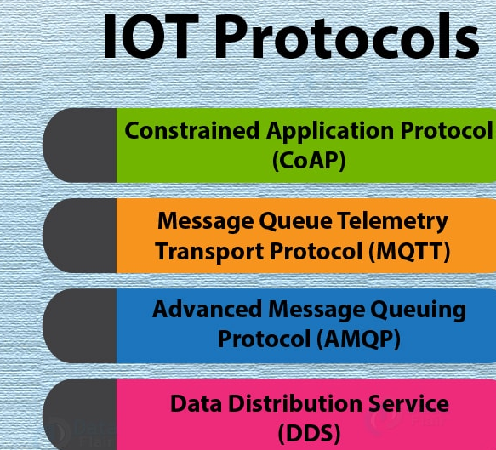

Slide 18
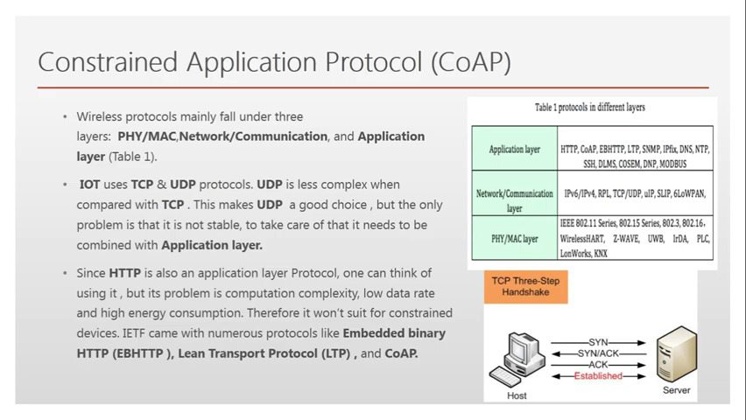

Slide 19
Constrained Application Protocol (CoAP)
CoAP is an internet utility protocol for constrained gadgets.
It is designed to enable simple, constrained devices to join IoT through constrained networks having low bandwidth availability.
This protocol is primarily used for machine-to-machine (M2M) communication and is particularly designed for IoT systems that are based on HTTP protocols.
CoAP makes use of the UDP protocol for lightweight implementation. It also uses architecture, which is just like the HTTP protocol

Slide 20
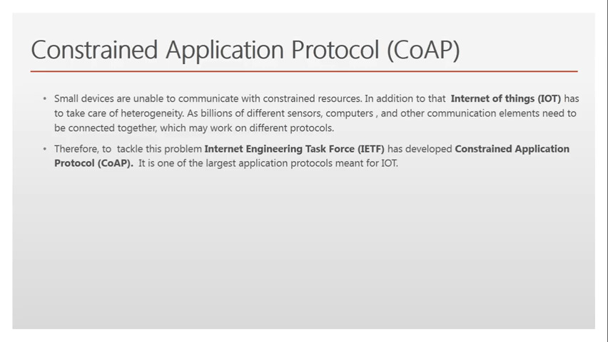
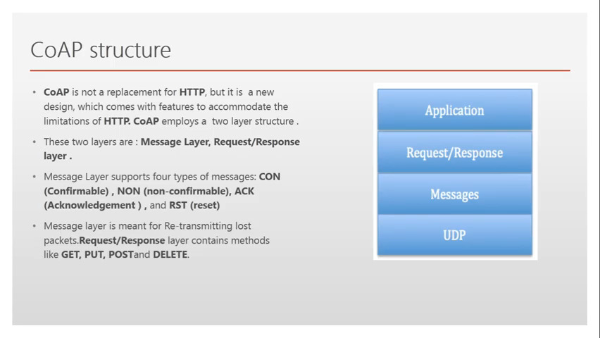

Slide 21
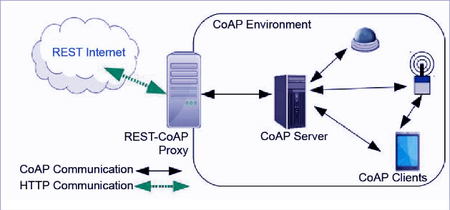

Slide 22
Popular Internet of Things Protocols, Standards and Communication Technologies
MQTT
MQTT (Message Queue Telemetry Transport) is a lightweight protocol for sending simple data flows from sensors to applications and middleware.
The protocol functions on top of TCP/IP
MQTT suits small, cheap, low-memory and low-power devices.
Includes three components: subscriber, publisher and broker.
The publisher collects data and sends it to subscribers.
The broker tests publishers and subscribers, checking their authorization and ensuring security.

Slide 23
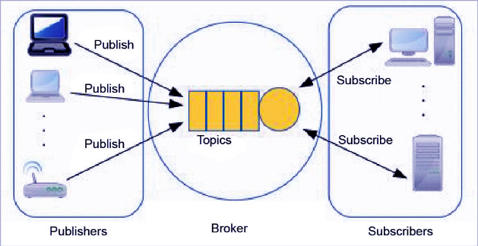
The writer generates the information and transmits the facts to subscribers through the dealer. The dealer guarantees safety by means of move-checking the authorization of publishers and subscribers.

Slide 24
DDS DDS (Data Distribution Service) is an IoT standard for real-time, scalable and high-performance machine-to-machine communication. It was developed by the Object Management Group (OMG).
The DDS standard has two main layers:
* Facts centric submit-subscribe (dcps)
* Statistics-local reconstruction layer (dlrl).
dcps plays the task of handing over the facts to subscribers, and
dlrl layer presents an interface to dcps functionalities, permitting the sharing of distributed data amongst IoT enabled objects.

Slide 25
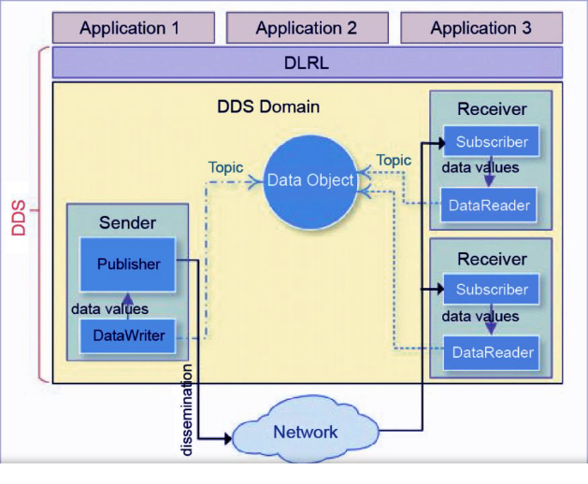

Slide 26
DDS
It enables a scalable, real-time, reliable, excessive-overall performance and interoperable statistics change via the submit-subscribe technique. DDS makes use of multicasting to convey high-quality QoS to applications.
DDS is deployed in platforms ranging from low-footprint devices to the cloud.

Slide 27
AMQP
AMQP (Advanced Message Queuing Protocol) is an application layer protocol for message-oriented middleware environments. It is approved as an international standard.
It supports reliable verbal exchange through message transport warranty primitives like at-most-once, at least once and exactly as soon as shipping.

Slide 28
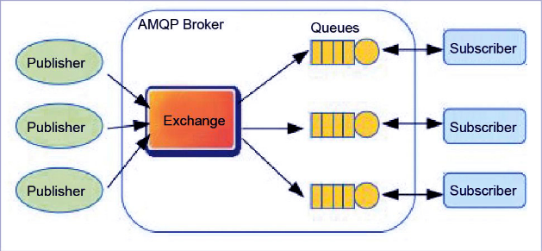
AMQP

Slide 29
The AMQP – IoT protocols consist of hard and fast components that route and save messages within a broker carrier, with a set of policies for wiring the components together.
The AMQP protocol enables patron programs to talk to the dealer.
This version has the following three additives,
which might link into processing chains in the server to create the favored capabilities.
Exchange: Receives messages from publisher primarily based programs and routes them to ‘message queues’.
Message Queue: Stores messages until they may thoroughly process via the eating client software.
Binding: States the connection between the message queue and the change.

Slide 30
LoRaWAN
LoRaWAN (Long Range Wide Area Network) is a protocol for wide area networks. It is designed to support huge networks (e.g. smart cities) with millions of low-power devices.
LoRaWAN can provide low-cost mobile and secure bidirectional communication in various industries.

